Slide 1
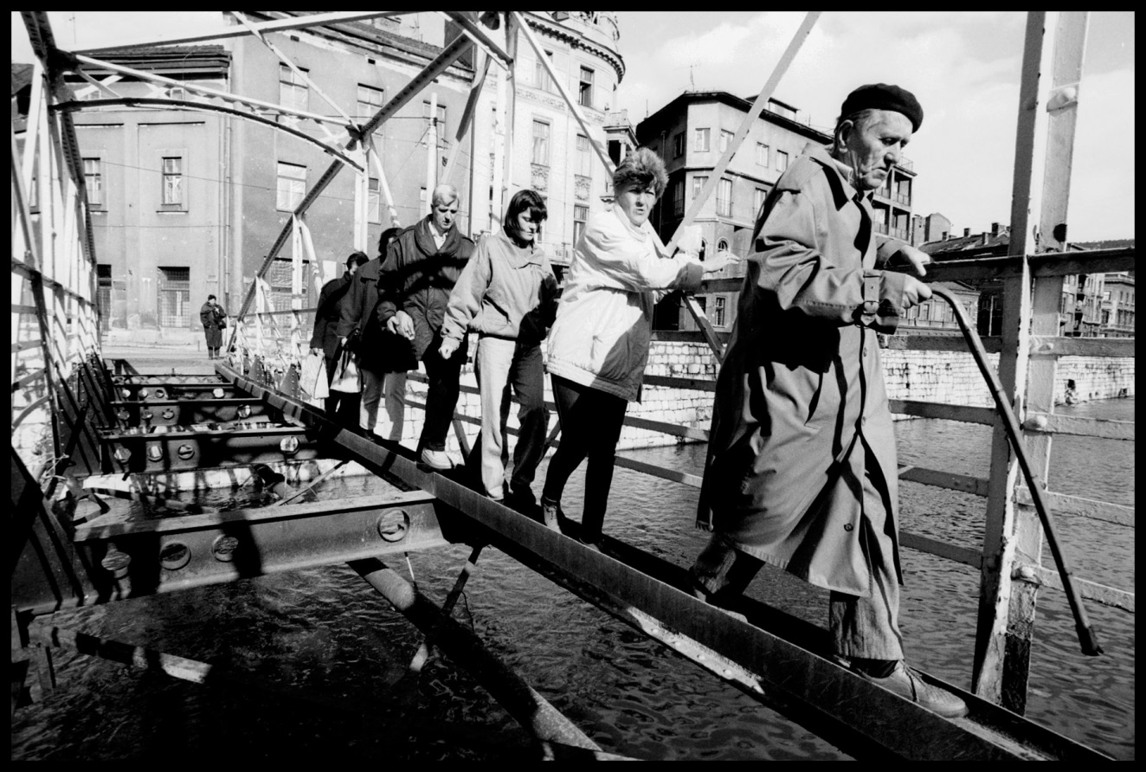
  “Beyond Boundaries”
  A Three-Part Lesson (including Gallery Walk Presentation Day)
  Mr. Price
  Julius West Middle School

Slide 2
Today’s Class:
By the end of class, historians will be able to…
Identify commonalities in the face of difference between peers
Analyze a quote and images highlighting the Jewish community in Sarajevo
Topic: “Beyond Boundaries, Part 1,” 5.3.17

Slide 3
Warm-Up:
Where the Wind Blows
Topic: “Beyond Boundaries, Part 1,” 5.3.17

Slide 4
Warm-Up: Debriefing Questions
Where the Wind Blows
What do you think was the purpose of this activity?
Did you learn anything you did not already know about your peers? If so, what was it?
Topic: “Beyond Boundaries, Part 1,” 5.3.17

Slide 5
Video:
Survival in Sarajevo
YOUR TASK: Fill in your graphic organizer during the film “Survival in Sarajevo”.
Topic: “Beyond Boundaries, Part 1,” 5.3.17

Slide 6
Video:
Survival in Sarajevo
YOUR TASK: Turn & Talk– share responses with your neighbor
Topic: “Beyond Boundaries, Part 1,” 5.3.17

Slide 7
Photo Analysis:
Study the photograph for 1 minute to form a complete impression of what makes up the image.
Then, divide the photograph into quadrants and study each quadrant to see what new details become visible.
Fill in your chart by recording the details you observe from each photograph.
Topic: “Beyond Boundaries, Part 1,” 5.3.17

Slide 8
Image #1:

Slide 9
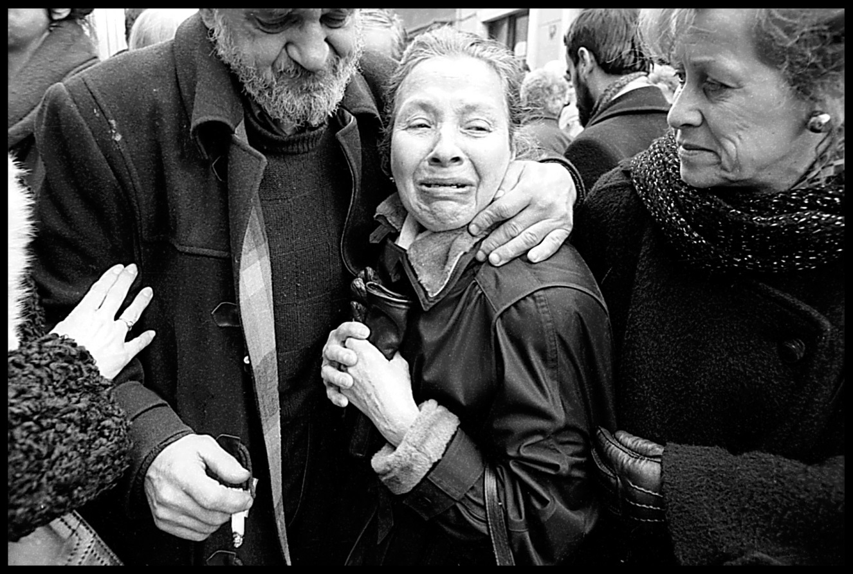
Image #2:

Slide 10
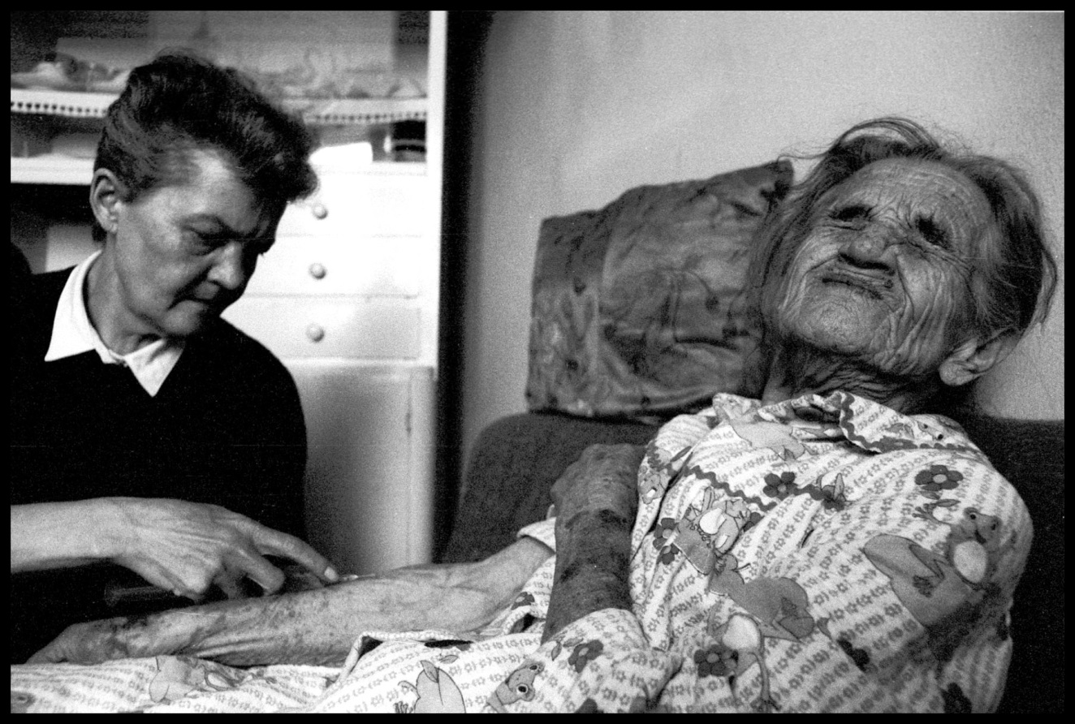
Image #3:

Slide 11
Homework:
What questions do you have about the people of Sarajevo or La Benevolencija? Come up with two good questions to ask a neighbor tomorrow.
Topic: “Beyond Boundaries, Part 1,” 5.3.17

Slide 12
Topic: “Beyond Boundaries, Part 2,” 5.4.17
[1st Things 1st]:
YOUR TASK: Have a seat and take out the following:
Your ‘Milton Wolf Student Learning Packet’
A sharpened pencil or pen

Slide 13
Today’s Class:
By the end of class, historians will be able to…
Analyze a quote and images highlighting the Jewish community in Sarajevo
Construct a visual representation highlighting the impact of the people of La Benevolecija
Topic: “Beyond Boundaries, Part 2,” 5.4.17

Slide 14
Warm-Up:
What specific details can you recall from yesterday’s class?
Topic: “Beyond Boundaries, Part 2,” 5.4.17

Slide 15
Quote Analysis:
“Don’t. Don’t. Don’t live under this dream that the West is going to come in and sort this problem out. Don’t dream dreams.”
—David Owen, European Community’s Chief Negotiator, to residents of Sarajevo, December 1992.
Topic: “Beyond Boundaries, Part 2,” 5.4.17

Slide 16
Instagram Project:
Prompt: The Jewish community of Sarajevo looked beyond religious and cultural differences to unite at the time of the Bosnian War. Create an original Instagram post (following the expectations of the attached rubric) that highlights the role of the people of La Benevolecija but also draws on the importance of the two quotes below.
“When the Jews are leaving, it is a bad sign for the city,”—Bosnian proverb
“In the end, we will remember not the words of our enemies, but the silence of our friends,”—Dr. Martin Luther King, Jr.
Topic: “Beyond Boundaries, Part 2,” 5.4.17

Slide 17
Homework:
Complete your Instagram Project.
Topic: “Beyond Boundaries, Part 2,” 5.4.17

