Slide 1
“Three Promises”
The story of the Kalef family of Belgrade

Slide 2
School: HRS-NMS Lassnitzhöhe (near Graz) – Austria
Students: 4th grade, 20 pupils – 14 years old
Teacher: Ulrike Lackner

Slide 3
Basic considerations:
Why should my students be interested in watching this film?
What can I do to attract their attention?
How can I make them aware of the fact that the Kalef story took place a long time ago?

Slide 4
1. INTRODUCTION
Material:
Photo copies: 20 different pictures of the Kalef family taken from the Centropa database (alternatively only 10 different ones so that 2 students get the same copy)
The photos are wrapped in thick brown paper (like Matilda’s mother did at the beginning of the war to protect the family photos and important documents)

Slide 5
1. The teacher shows the parcel, students guess: what could be in it?
For example: a gift, a book, a picture, documents, a newspaper, photos (If they don’t find out, the teacher tells them) and asks: why could photos be wrapped up like this?
For example: to send them away, to protect them, to give them to somebody, to hide them

Slide 6
2. The teacher tells the story of the photos (taken from the bio)
“Before mother left our apartment she stowed away our pictures and documents. We are very lucky that the pictures were saved. This was due to the fact that my mother was so smart and wise. She wrapped all these pictures and documents in thick brown paper. She took the parcel and she squeezed it in between a beam and tiles in the attic in order to protect it. If we survived, and if we returned, we would have some proof that we were the legal children of Jewish origin and about the property and everything. In addition to the pictures and documents that my mother hid there was also Jakov's tallit and tefillin. That was it. Mother saved these things. One time [after the war] I was looking for something and found them.”

Slide 7
3. The teacher opens the parcel
Explain why it is very different to regain your own family photos, like the Kalefs did after the war, compared to finding pictures of unknown people like the students will do now.

Slide 8
4. Discussion on what could be of interest regarding the photos?
Examples:
WHO is the person/one of the persons?
WHEN was the picture taken?
WHERE was the picture taken?
WHY was the picture taken?

Slide 9
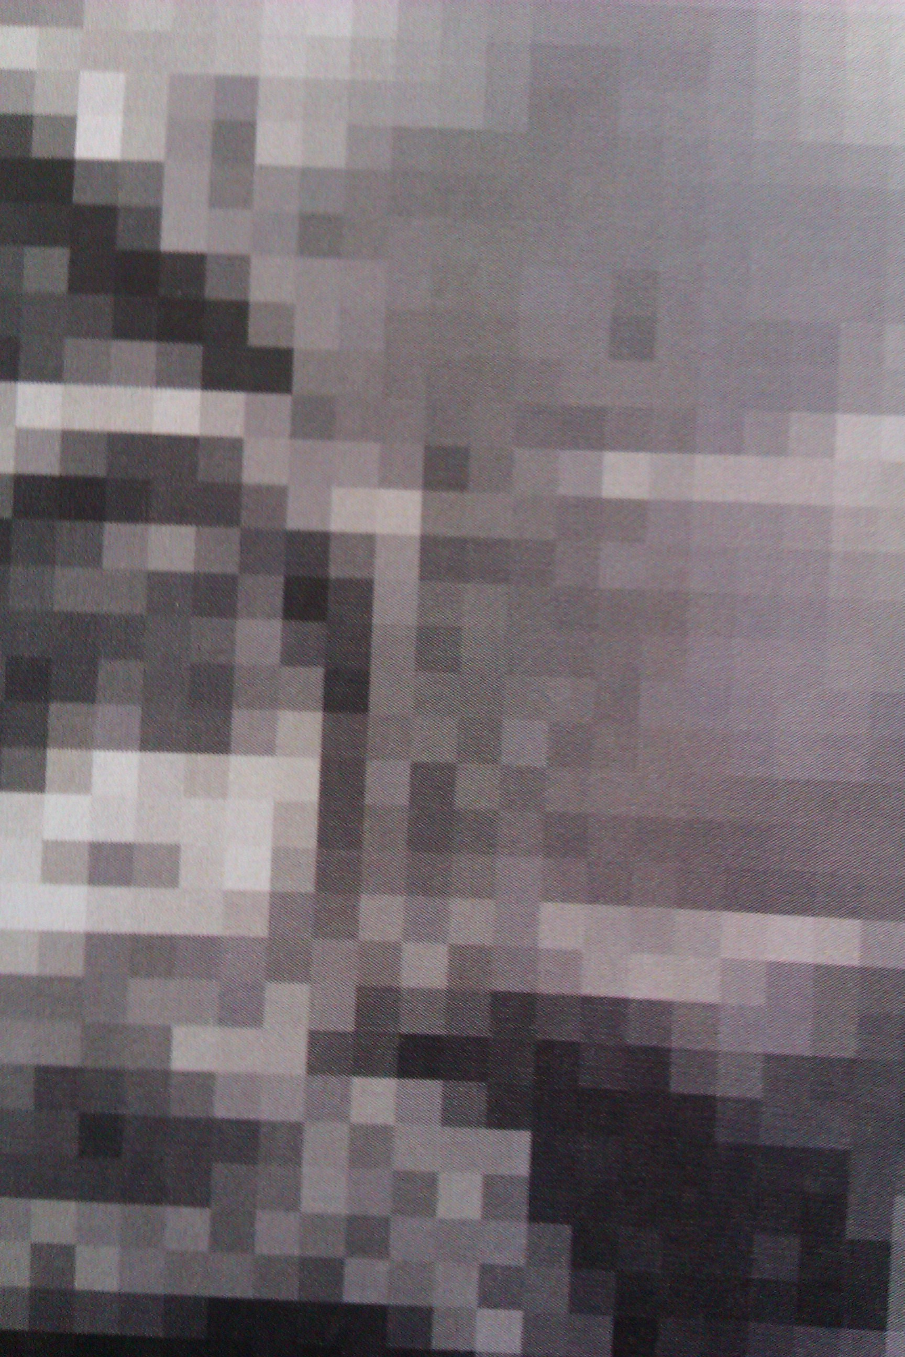
5. Every student takes one of the blurry copies.

Slide 10
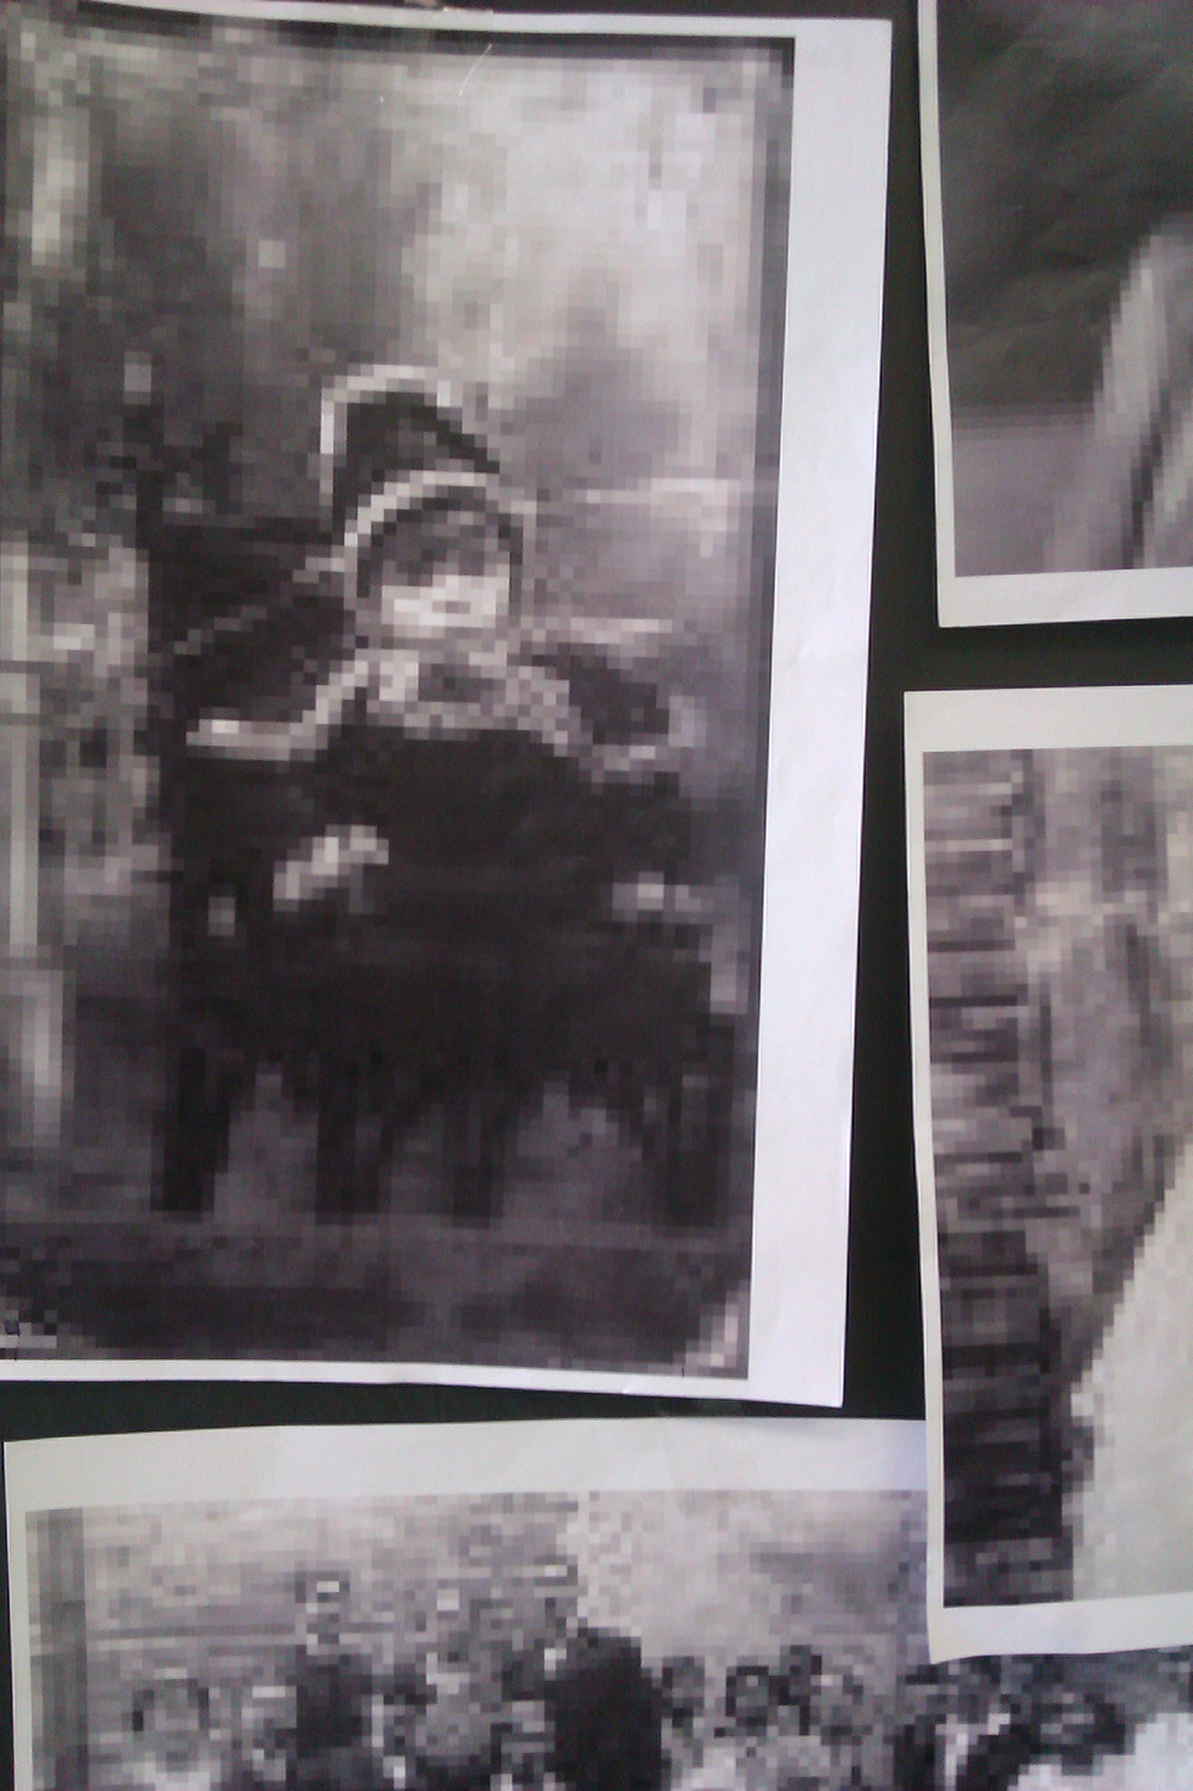
6. The students watch the film, recognize their photo and write as much information as possible on the back of the photo copy.

Slide 11
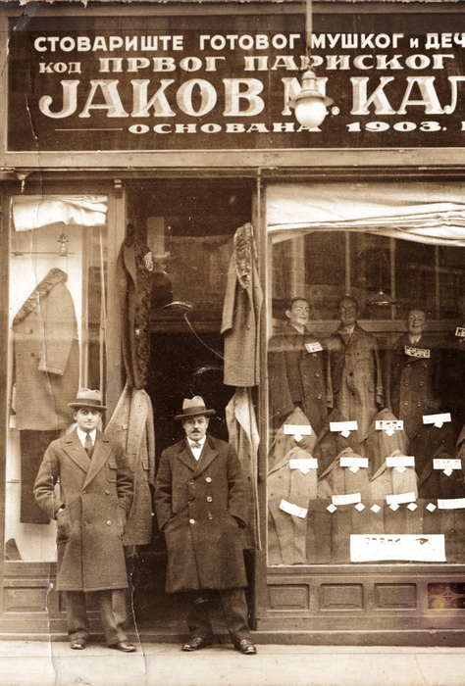
2. STUDENTS WATCH THE FILM
http://www.centropa.org/centropa-cinema/matilda-kalef-three-promises

Slide 12
3. FORMING A TIME-LINE
All students:
start to reconstruct the story of the Kalef family by putting the photos in order and fixing them on the board in a kind of timeline
read the information about the photo and stick it on the board
walk to the back of the classroom (without looking back)
turn around again and look at the pictures.
They will find out that the blurry copies are really sharp when you look at them from a distance.

Slide 13
When Matilda and Breda Kalef found their family pictures again after the war there had been a distance in time.
To have a clear look at the story of the Kalef family, the students have to have a distance in space.

Slide 14
Some reactions of my students:
When you can’t see something clearly, you sometimes misunderstand the meaning.
You should always be interested to get into detail and find out more (especially before you judge).
After watching the film I got more information. We put the pictures into a timeline and when we were looking at them from a distance we had both: the information and a clear picture.

Slide 15
PS. What about a translation of the film into German, would be interesting for students in Austria and Germany!

