Slide 1


On-Site Learning
A Special approach to Generation Z
„Promoting civil society and Jewish history in Moldova, Ukraine and the Visegrad countries“
Zsolt István Vódli
Riscova, 25-27 October, 2019

Slide 2

On-Site Learning - Overview
Why Choose On-Site Learning?
Challenges
Centropa - Berlin Calling

Slide 3


Why Choose On-Site Learning?
Tailoring high quality programs to meet students needs
Language (English / German)
Learning through Exploration and Discovery (different views)
Better understanding
Increase engagement by involving students
Maximize flexibility with timing and location
Enable direct interaction with guides, peers and teacher(s)
Encourage discussions to include different narratives
See & Hear (50%) / + Collaboration (70%) / + Doing (80%)

Slide 4
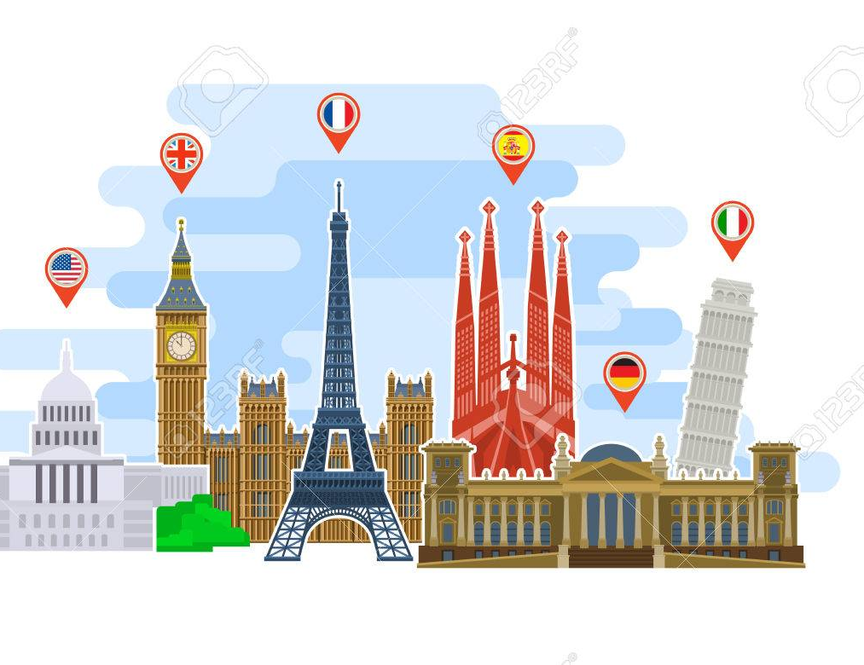
On-Site Learning Programmes
On-Site learning? Study trip?
Visiting museums
Guided tours in English / German
Mini lectures by students
Workshop (working with students from another country (Poland))
Sightseeing
Quiz

Slide 5
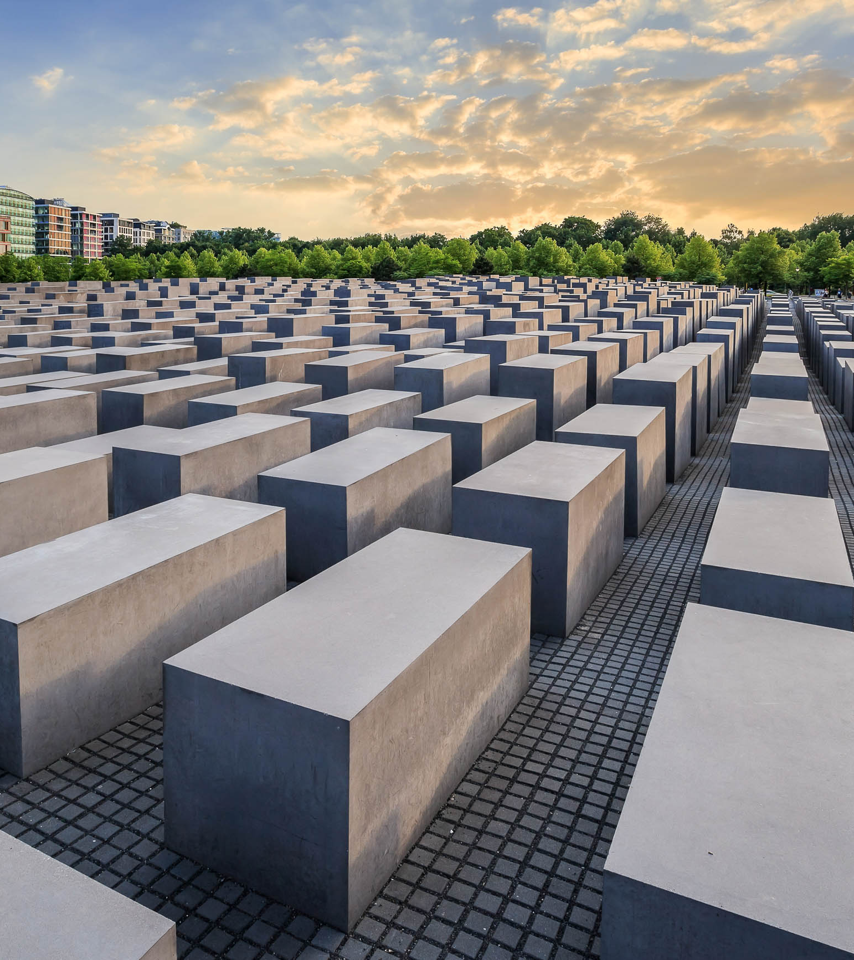
Possible Challenges
Emerging problems
  Behaviour
    Laughing, photography, selfie
  Handling emotions
    What to do in case of a panic attack?
  Embarrassing situations
Question and Answers
What did I learn?
  What was most interesting to me? What else do I want to know?
Personal discussions

Slide 6
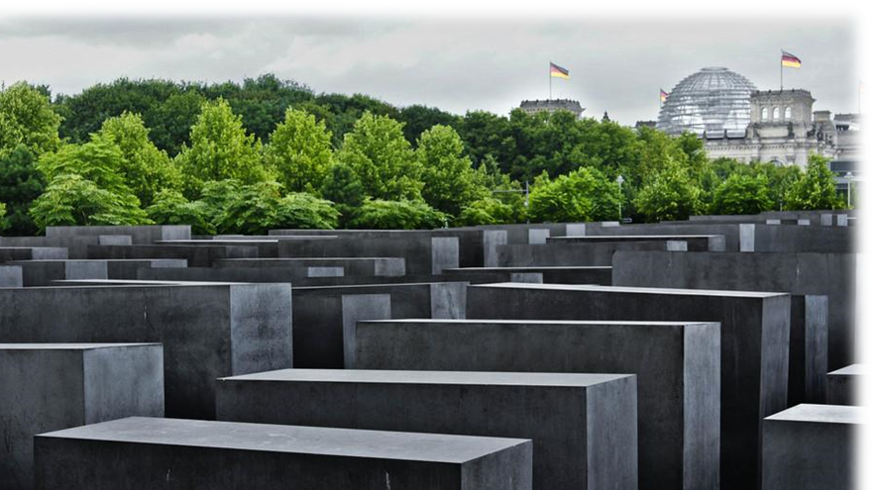
Berlin Calling
A study trip a’la centropa

Slide 7
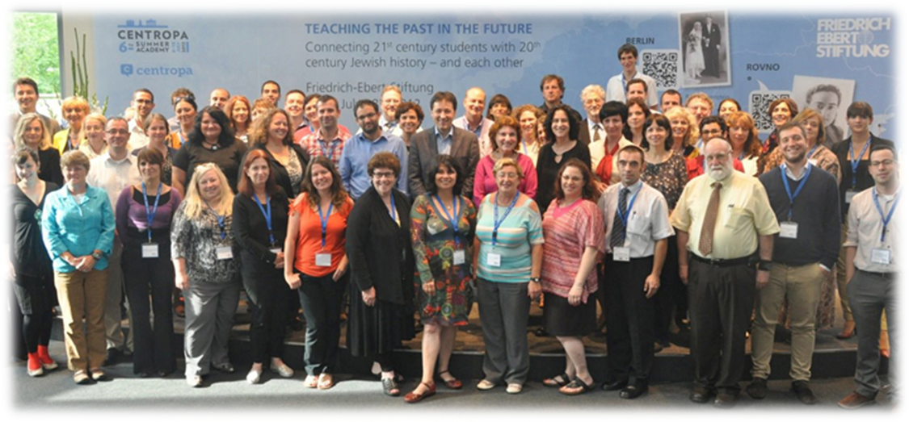
Centropa Summer Academy 2012

Slide 8
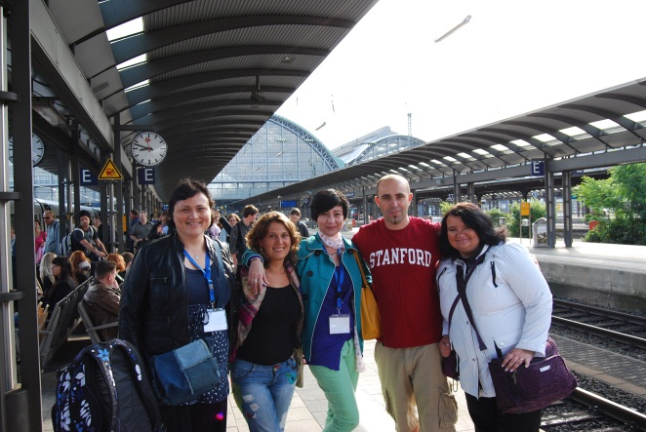
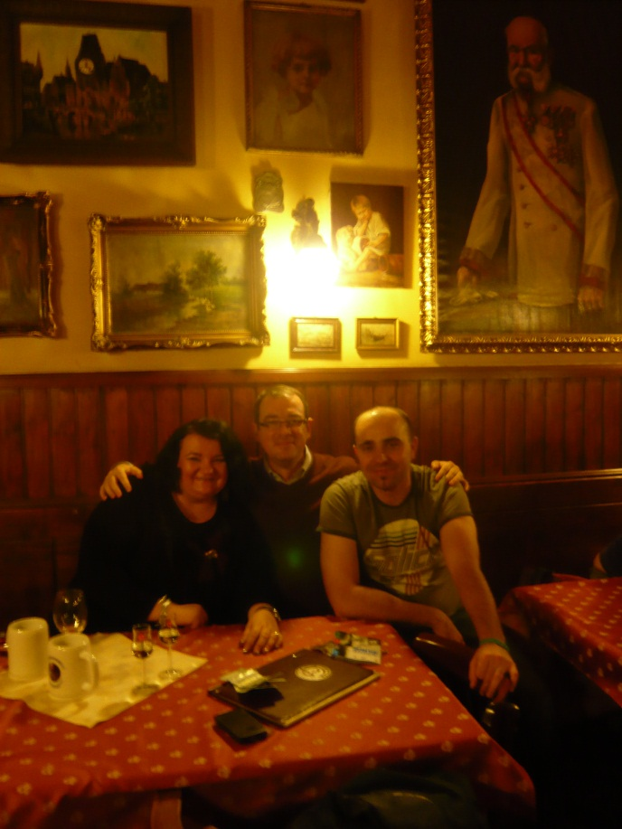
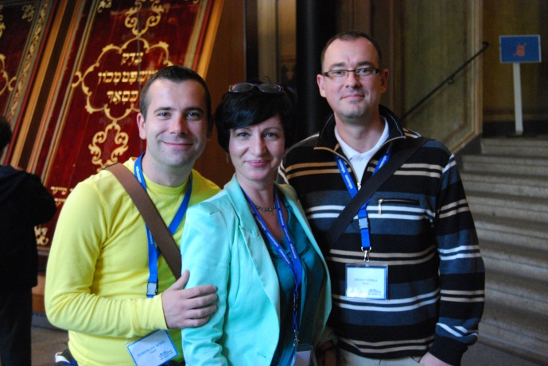
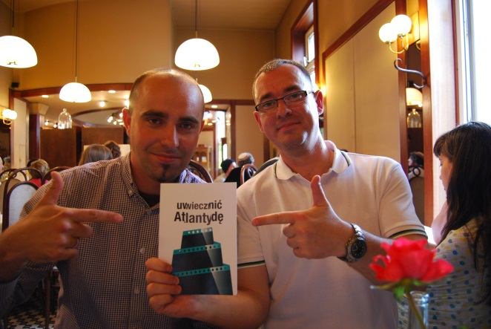
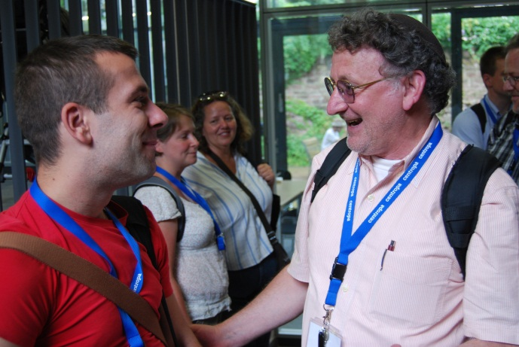
What did I get?
Knowledge & Friends & Inspiration ☺

Slide 9
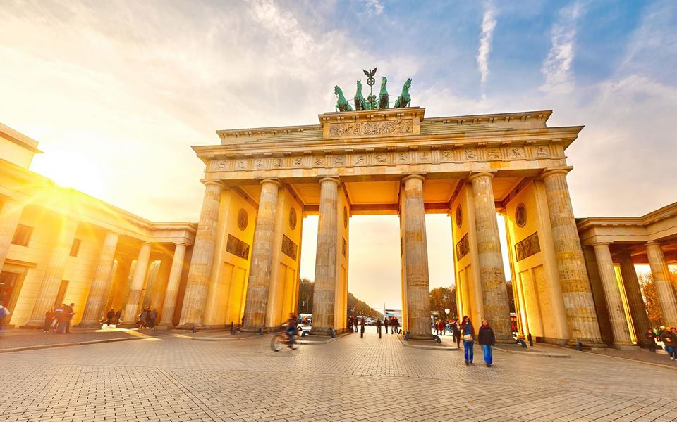
Study Trip to Berlin
Main focus on the 20th Century
The study trip combines the traditional and special interests
Great importance attached to the Memorials

Slide 10
Berlin, Berlin
I. Preparation
Facebook group, Pre-trip assignements: Berlin cards, movies, recommended readings
II. On the spot
Memorial places/monuments/memorials/memorial plaques, museums– guided tours, cemeteries,important buildings
III. Reflections: presentation(s), quiz, test(s)

Slide 11
Preparation
Getting started
Facebook group
Pre-trip assignements
Berlin cards

Slide 12







Movies

Slide 13
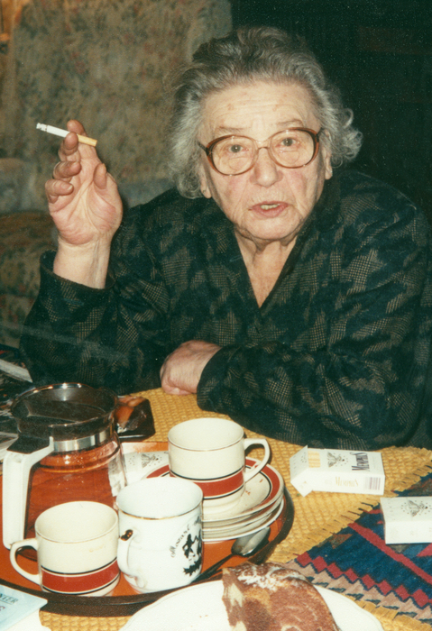
Centropa films
Rosa Rosenstein: Living with History
  The story of a Berlin-born Jewish woman
  She lived through the turbulent times
    growing up, falling in love, starting a famiy
    how integrated, assimilated Jewish families lived in Germany
Walking tour in Berlin
  in the footstep of Rosa Rosenstein
    personal stories – connect to the location

Slide 14
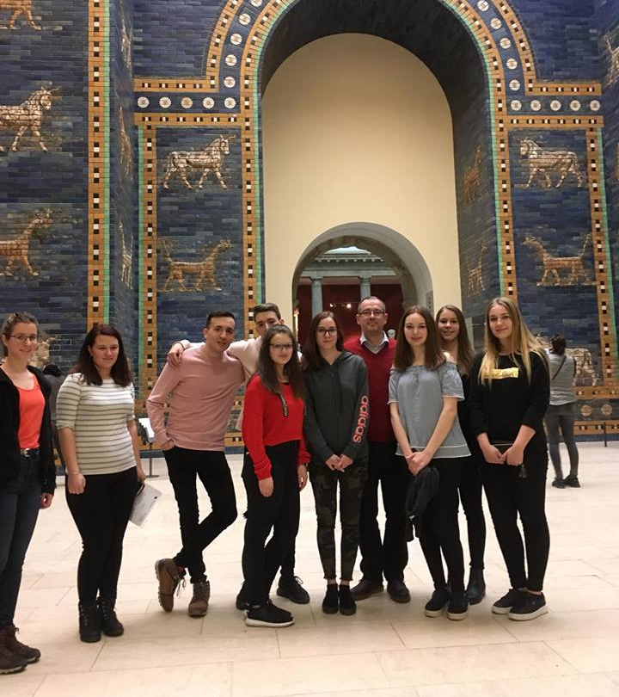
Berlin, Berlin
I. Preparation
Facebook group, Pre-trip assignements: Berlin cards, movies, recommended reading
II. On the spot
Memorial places/monuments/memorials/memorial plaques, museums– guided tours, cemeteries,important buildings
III. Reflections: presentation(s), quiz, test(s)

Slide 15
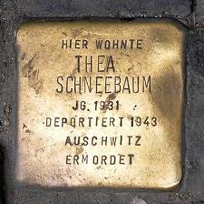
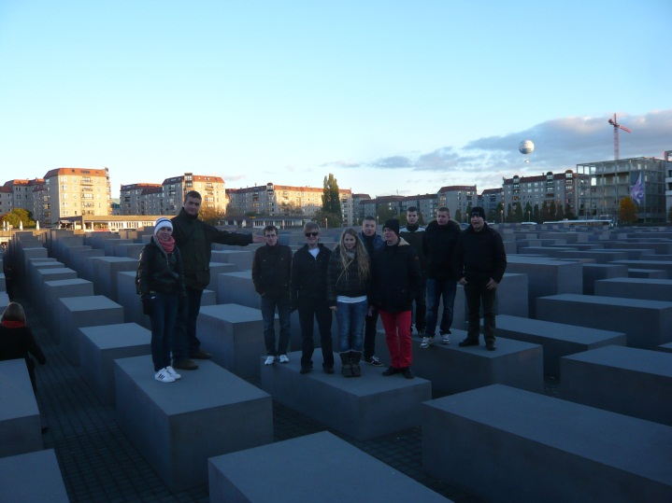
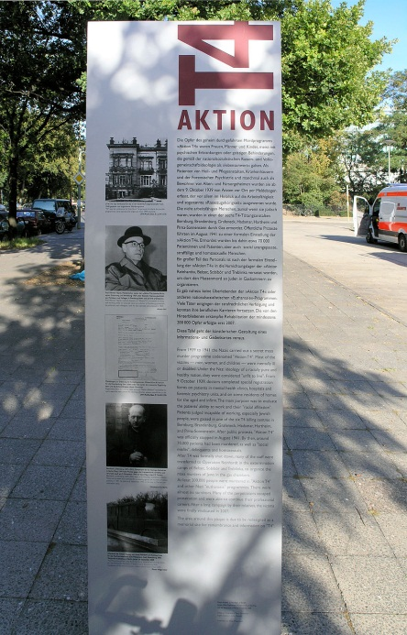
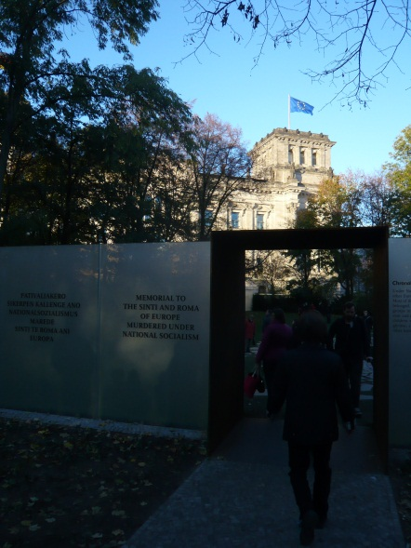
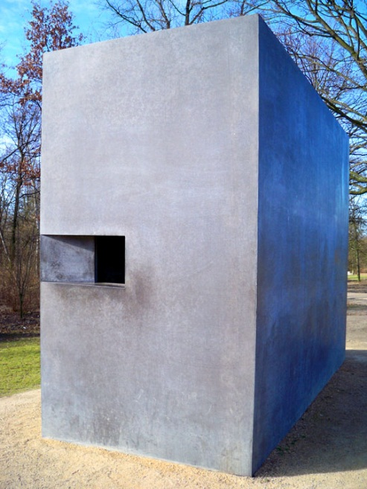

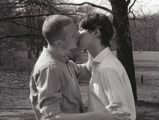
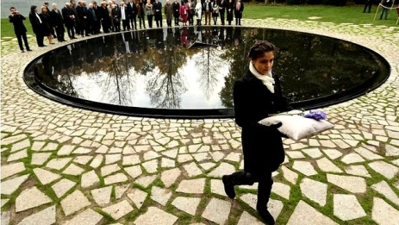
Culture of Remembrance

Slide 16
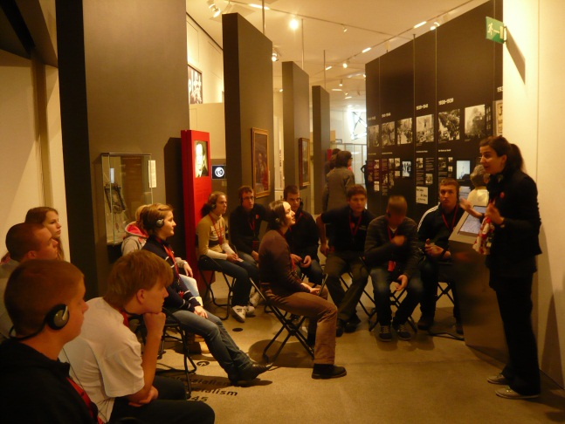
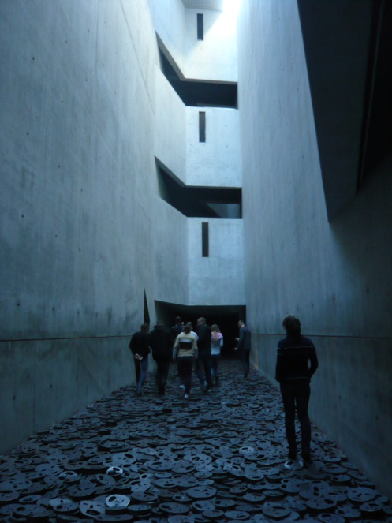
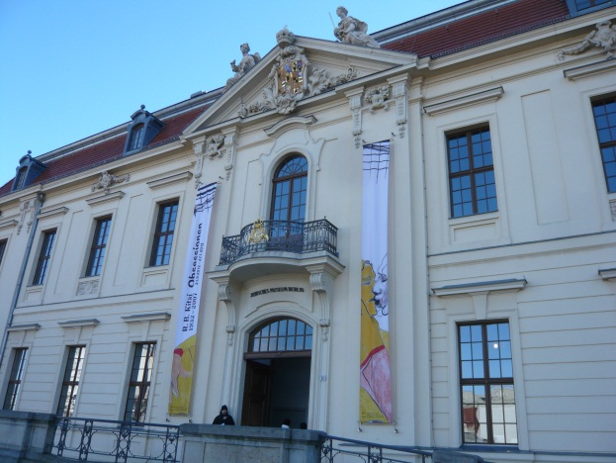
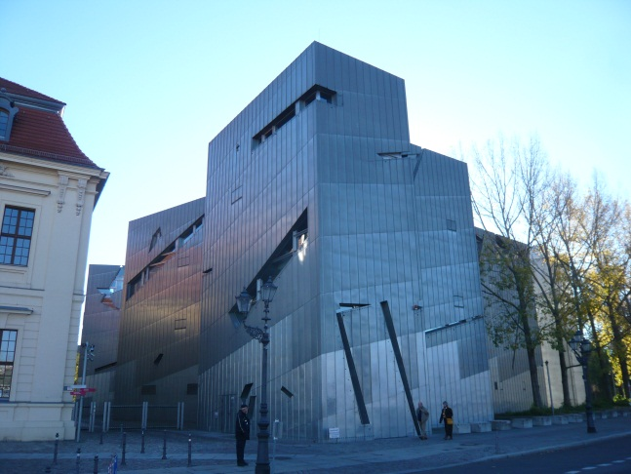
Jewish Museum Berlin

Slide 17
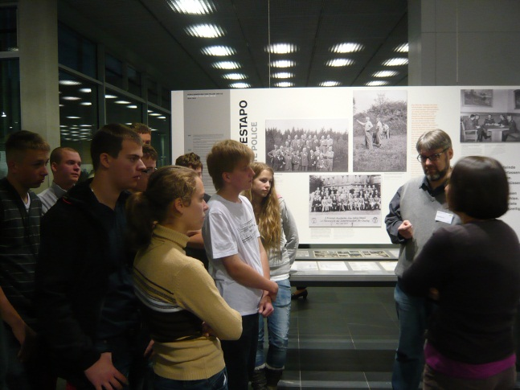
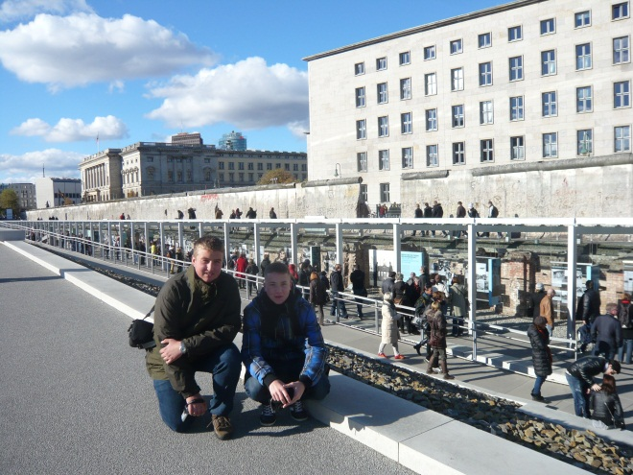
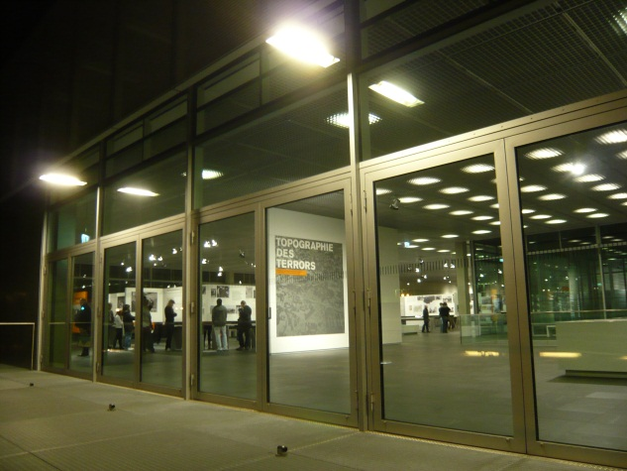
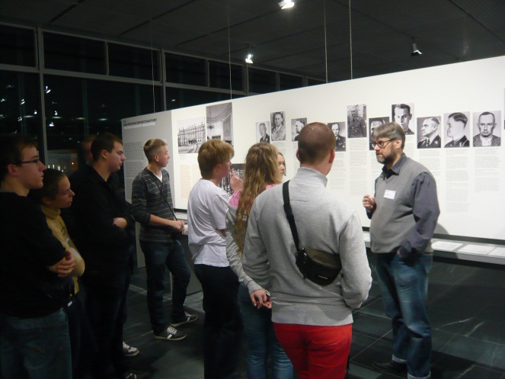
Topography of Terror

Slide 18
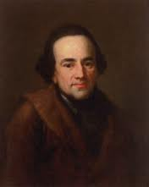
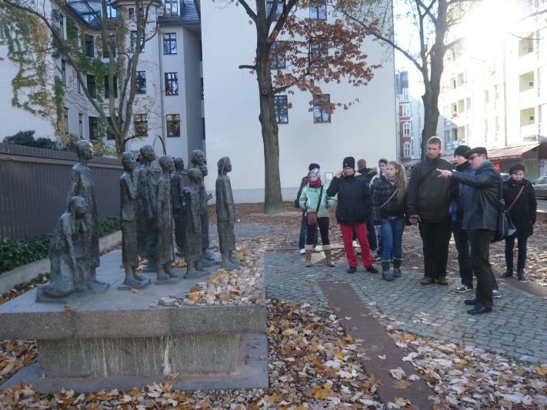
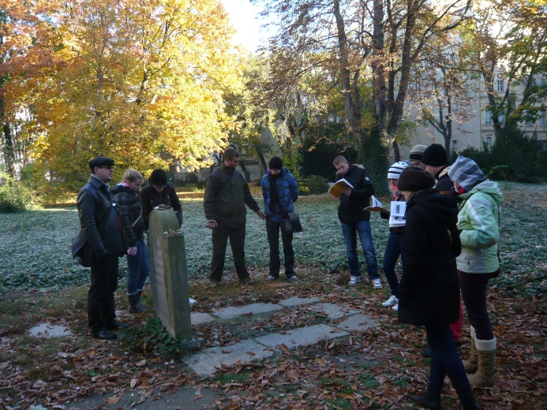
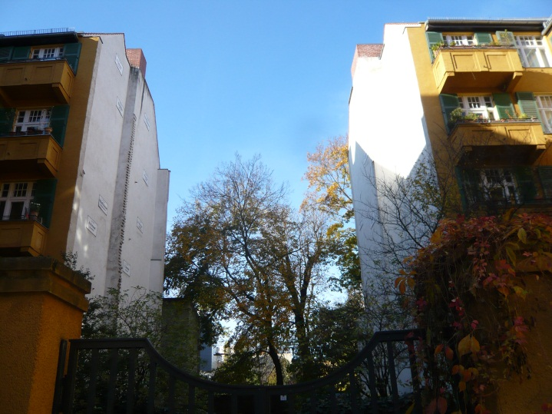
Große Hamburger Strasse
MOSES
MENDELSSOHN

Slide 19
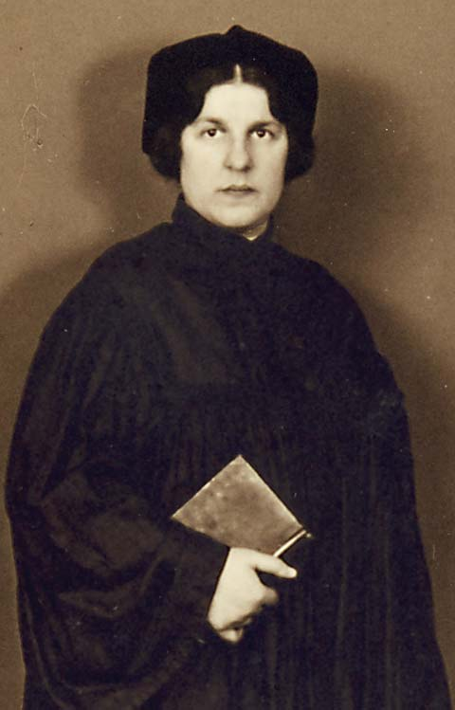


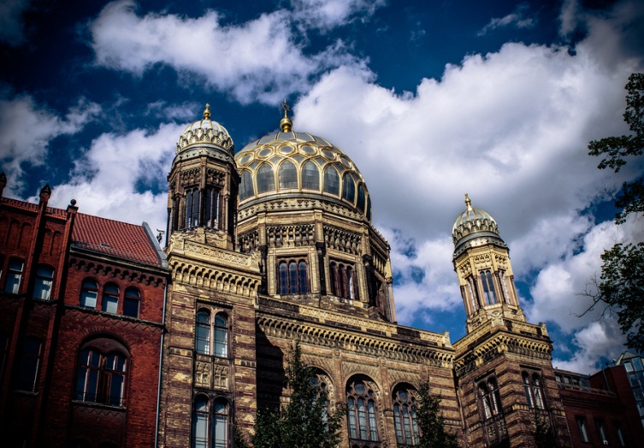
New Synagogue Berlin
REGINA JONAS

Slide 20
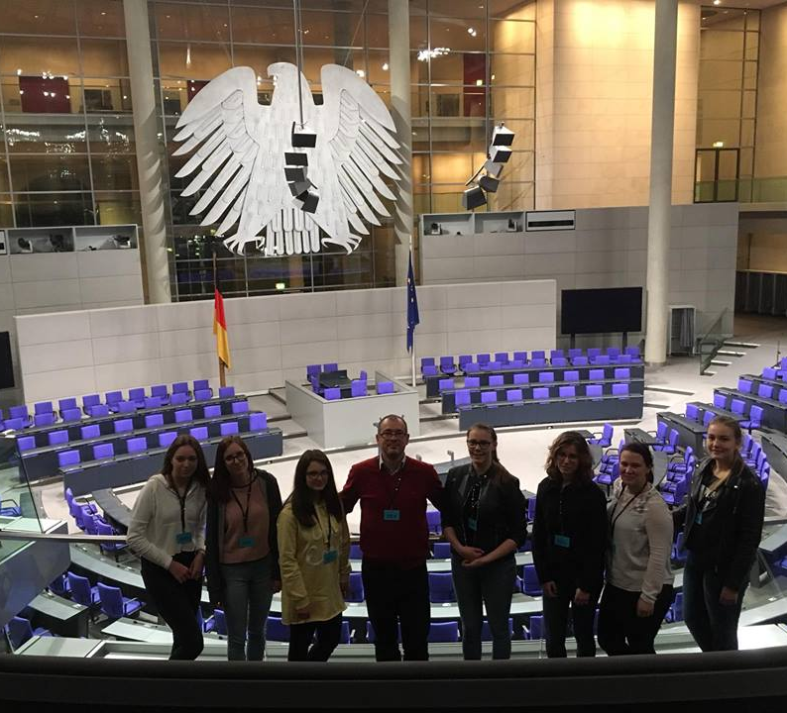
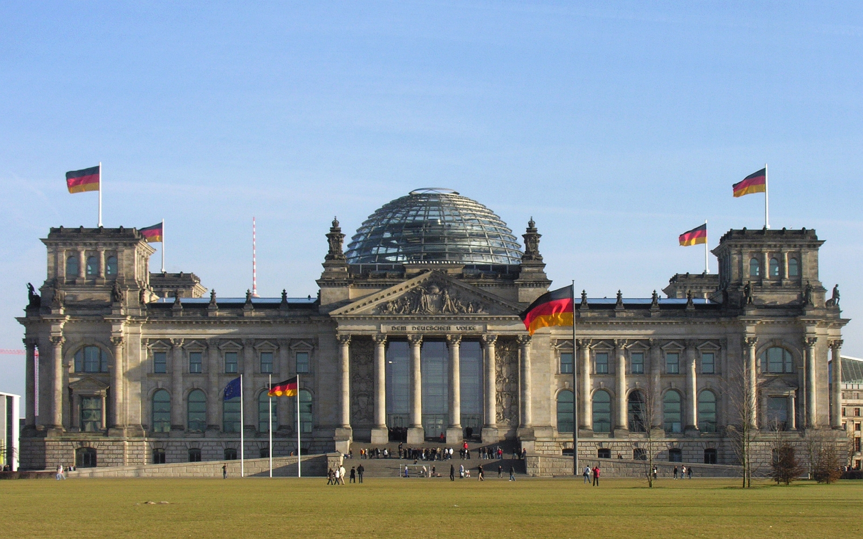
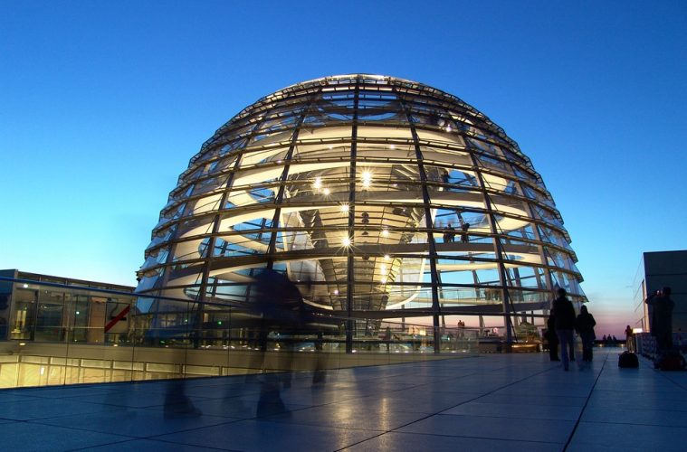
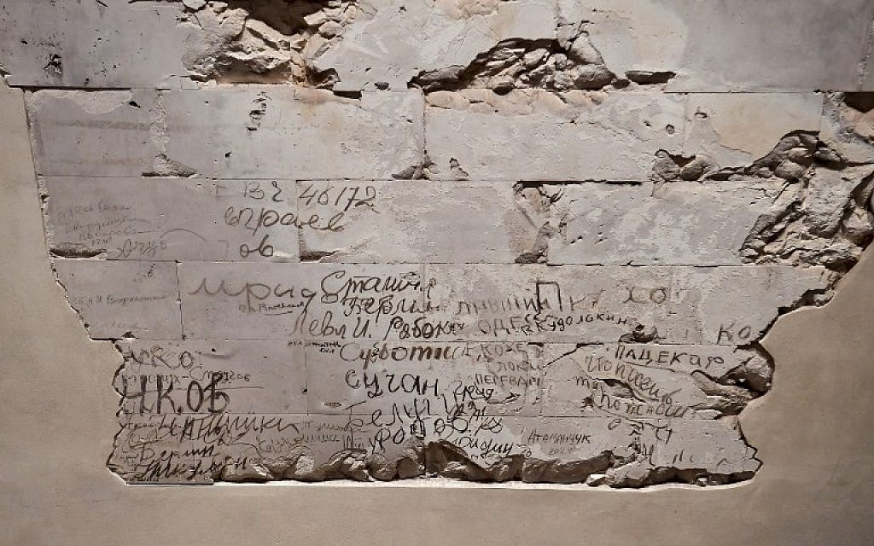
Visiting The Bundestag

Slide 21
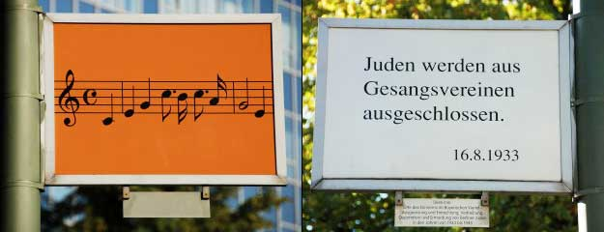
Impact
Visiting hidden places
Interesting facts
Q & A
Materials in different languages
To give an in-depth learning experience
"We’re standing in Schöneberg, which is probably best know to foreigners as the place where John F. Kennedy gave his “Ich bin ein Berliner” speech. But it’s also where the Nazis rounded up the city’s Jews.”

Slide 22
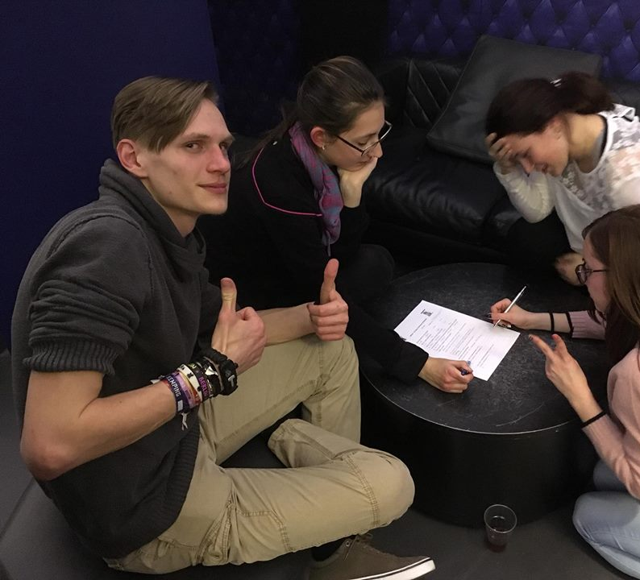
Berlin, Berlin
I. Preparation
Facebook group, Pre-trip assignements: Berlin cards, movies, recommended reading
II. On the spot
Memorial places/monuments/memorials/memorial plaques, museums– guided tours, cemeteries,important buildings
III. Reflections: presentation(s), quiz, test(s)

Slide 23

Follow up - Sharing thoughts
Discussions (group or individual)
  talking about experience, emotions
Personal stories
  meeting with survivals
  films , documentaries

Slide 24

Follow up - Project work
Workshop
  Writing
    Finding contact to a survival
    Sharing thoughts with a friend
    Travel journal – expressing feelings questions, thoughts
  Drawing - expressing emotions
  Video - making interviews
Article
  Writing an article about :
  ” What can be done against racism, antisemitism”

Slide 25
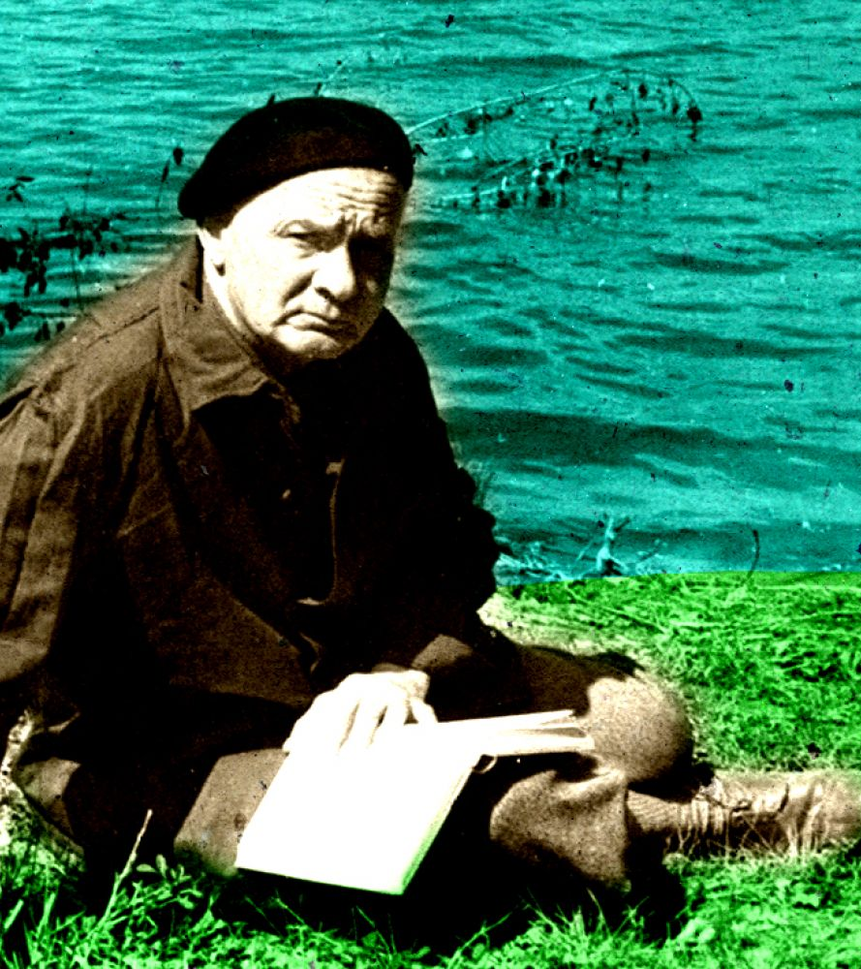
"Who wants to know the world, should stay at home; who wants to know himself, should travel."
(Hamvas Béla)

Slide 26


Slide 27
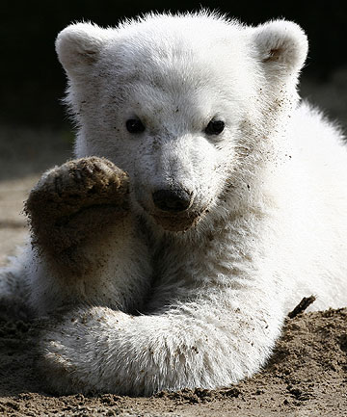




Thank You For Your Attention

