Slide 1
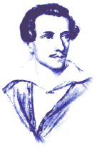
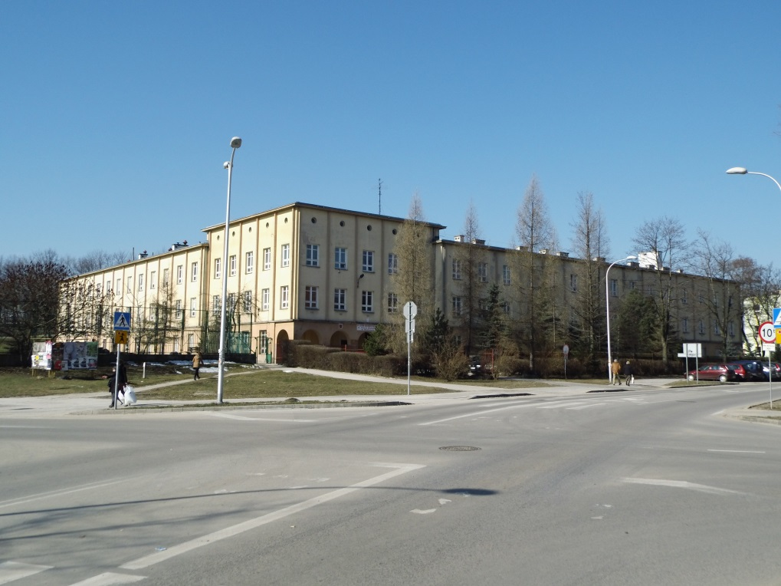
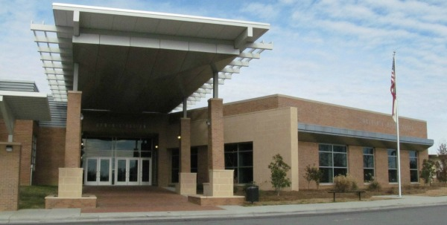

Centropa Kielce-Greensboro Project

Slide 2
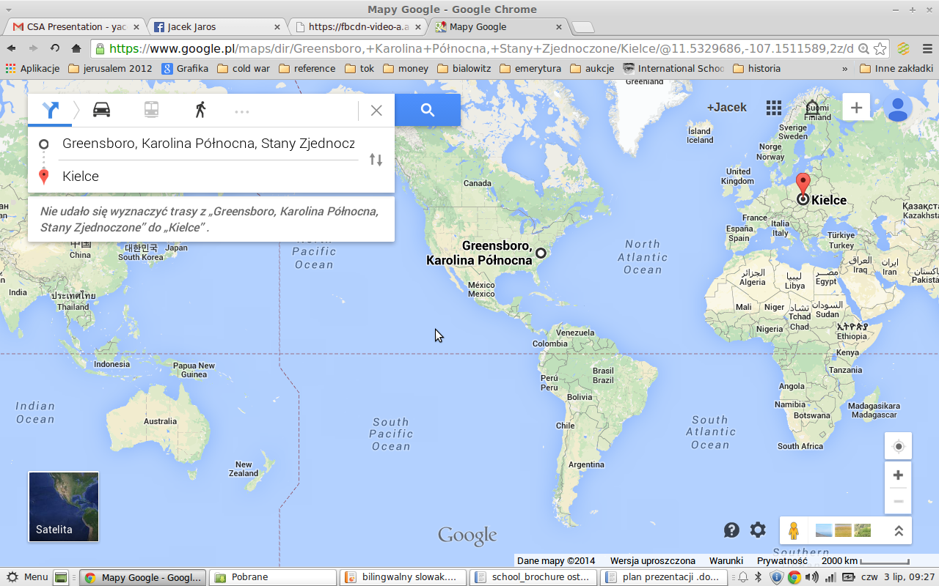

Centropa Kielce-Greensboro Project

Slide 3


Centropa Kielce-Greensboro Project

Slide 4
Centropa Kielce-Greensboro Project

Slide 5
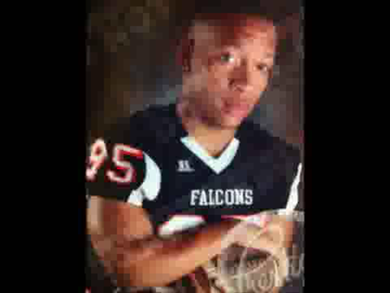
Centropa Kielce-Greensboro Project
Film about Mahalia Jackson
Notes:
https://www.youtube.com/watch?v=ZvveumEXfuY&feature=youtu.be

Slide 6


Centropa Kielce-Greensboro Project
My Story, Joasia Durlik
Notes:
https://www.facebook.com/photo.php?v=516442305132509&set=o.1453580204878487&type=2&theater

Slide 7
Centropa Kielce-Greensboro Project
It was like time travelling to a different world
Notes:
The students emphasized that they learned more about their own famlies' history and their hometowns. They discovered that multicultural links existed between their ancestors and their neighbours. They learned that the cities and towns they live in now used to be much more culture diversed. Moreover, two of my students who paricipated in the project received the first and second prices for the films they made about their ancestors. They participated in the competition organised by OMPIO (The Centre of the Patriotic and Civic Reflection (http://www.ompio.pl/images/o_nas/folder_en.p

