Slide 1
Kids Keep Charleston Clean
By: Braedon Love

Slide 2
Things To Know
Volunteer organization 20 members and growing
The way we are different is I will gather a group of friends to go to schools with me to help explain and tell kids what the difference between litter and trash is, why it is important to clean up litter and why litter is bad for the environment.
We clean up parks and streets once a Sunday every month
We provide tee shirts to volunteers
We provide trash bags, gloves, snacks, and refreshments
Additional information and up coming events can be found on our website at http://www.kidskeepcharlestonclean.org (Not mobile compatible).
Join and like our Facebook page at https://www.facebook.com/Kids-Keep-Charleston-Clean-1033391356691268/timeline/
Sing up to clean with us at http://www.signupgenius.com/go/10c084cafaf2aa64-kids

Slide 3
The Mission

Slide 4
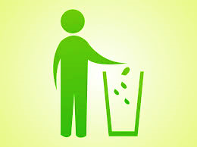
Mission Statement
The goal for Kids Keep Charleston Clean is to create a clean environment through education and activism. KKCC seeks to teach kids in the Charleston community the importance of keeping our beautiful city clean. KKCC focuses on the importance of stopping litter-bugs and teaching others the same. In addition to education, KKCC also encourages kids to participate in clean sweeps and become active community members despite age.

Slide 5
The Steps
Make a website to inform people.
Inform the younger children about the importance of not littering.
Organize dates to have the Clean Sweeps
Make a SignUp Genius
Have the Clean Ups on a Sunday every month.
Step 1
Make A Website
Step 4
Make Sign Up Genius
Step 5
Have Clean Sweeps
Step 2
Inform Children About Littering
Step 3
Organize Dates

Slide 6
Why?
Why is littering so bad?

Slide 7
What is Littering?
Cigarette Butts
Soda Cans
Coffee Cups
Beer Bottles
Plastic Bags
Gum Wrappers
Glass
And non organic matter that you could see on the side of the road, on a fence, park or the side walk.
Littering is any trash or garbage that is left in an open or public place. Some examples could be…

Slide 8
The Difference
Trash
Litter
Trash is thrown away into a garbage can such as empty bottles, used papers, bad food, etc.
Litter is like trash, but instead of putting into a trash can they were thrown on the ground. Unlike trash littler is not organic matter, so food is not litter. In Charleston people could be finned for throwing litter on the ground, but people still do it.

Slide 9
Why Is Litter So Terrible
Hurts Plants and Animals
Hurts our environment
Can get into our water and dissolve into micro plastics that can get into our tap water and hurt us.
If we do not address this problem then our cities and our streets will become and stay littered with trash. Litter is a big problem in this world, that’s why we need to form groups or organizations to stop this big problem. We can do this by educating the young and old students about littering and going on clean ups to clean up the litter.

Slide 10
Connections
Milton Wolf

Slide 11
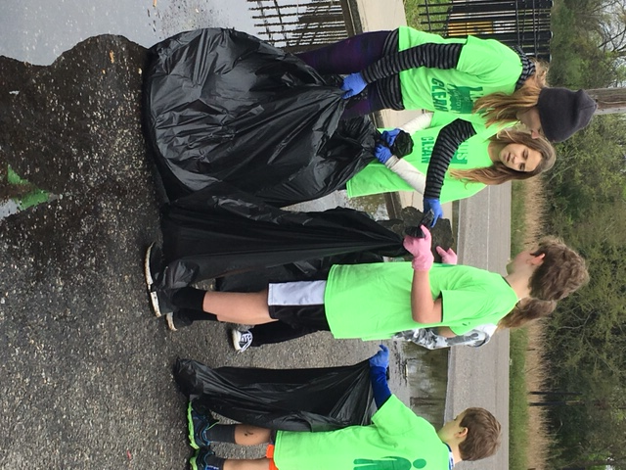
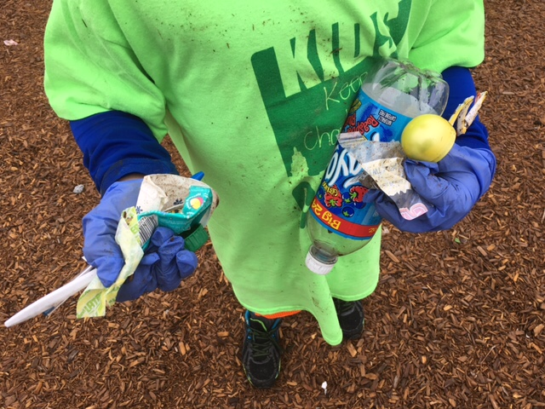
Milton Wolf
Milton Wolf made a difference and I am inspired by his commitment to also make a difference. I think by starting KKCC that I am making a small difference in my community.

Slide 12
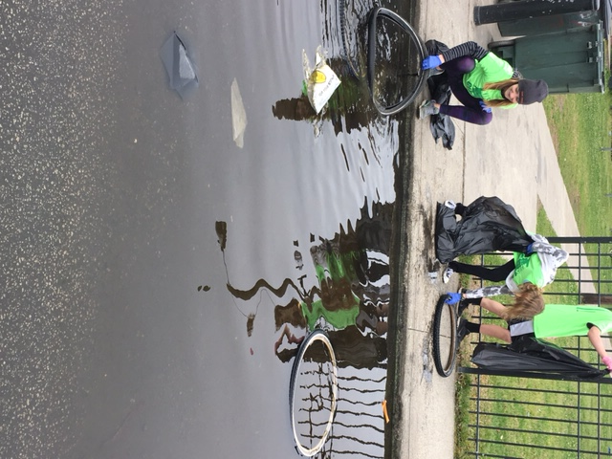
Survival in Sarajevo
Those in the film had to join together in order to make a difference in their community. There was a power in numbers. I think KKCC is very much like the film in that we all have to join together in order to make a difference in our clean up effort. Together we are cleaning up and educating others in order to make our community better.

