Slide 1
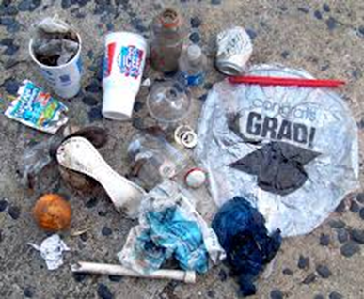
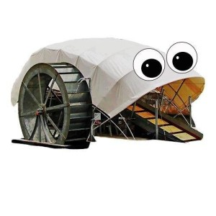
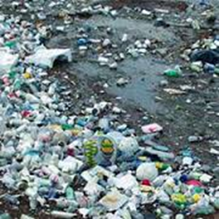
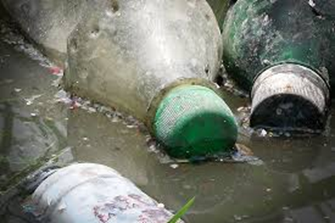
Baltimore's Trash Wheel: Addressing the Community Problem of Trash in our Waterways
Allison Kortte, Amy Hubbard, and Olivia Restelli

Slide 2
Objectives
Identify the problems created by littering and trash in our waterways
Describe one innovative solution to manage the trash in our waterways
Identify ways that the community can engage in management of trash

Slide 3
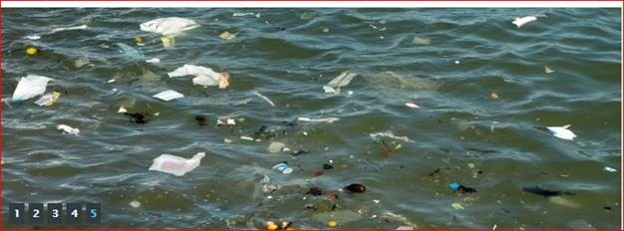
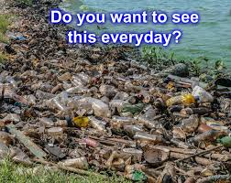
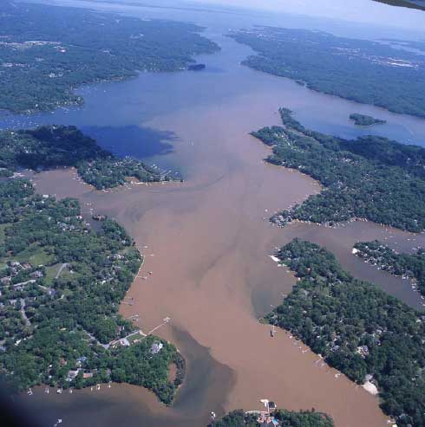
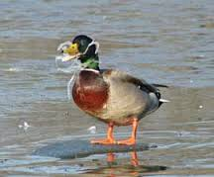
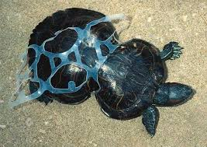
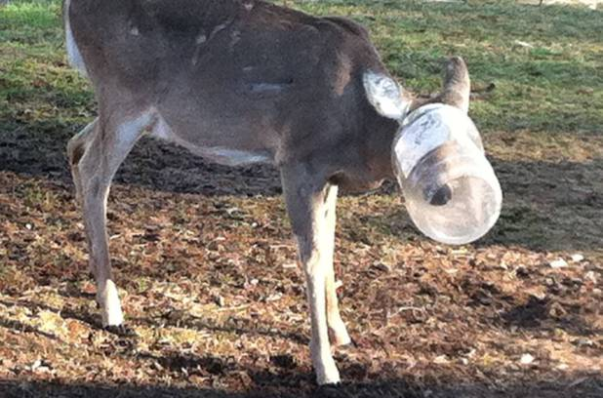
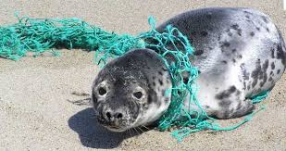
WHY IS POLLUTION IN THE HARBOR BAD?
Residents and tourists will not want to swim in these polluted waterways.
This “chocolate water” is downstream pollution to the Chesapeake Bay and beyond.
Because of the pollution, the water is full of chemicals and toxins that are harmful to fish, waterfowl, shore animals, and humans.
Trash injures land, water, and shore animals.
https://blog.epa.gov/blog/tag/trash/

Slide 4
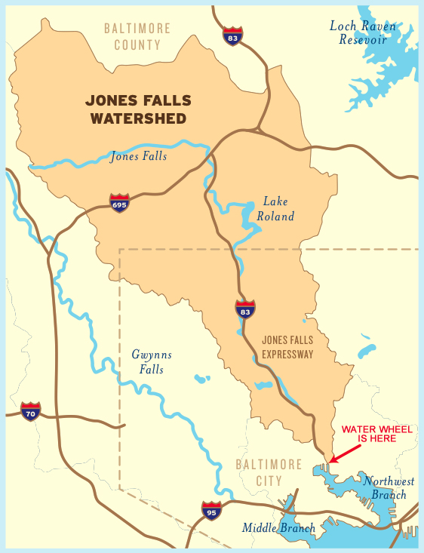
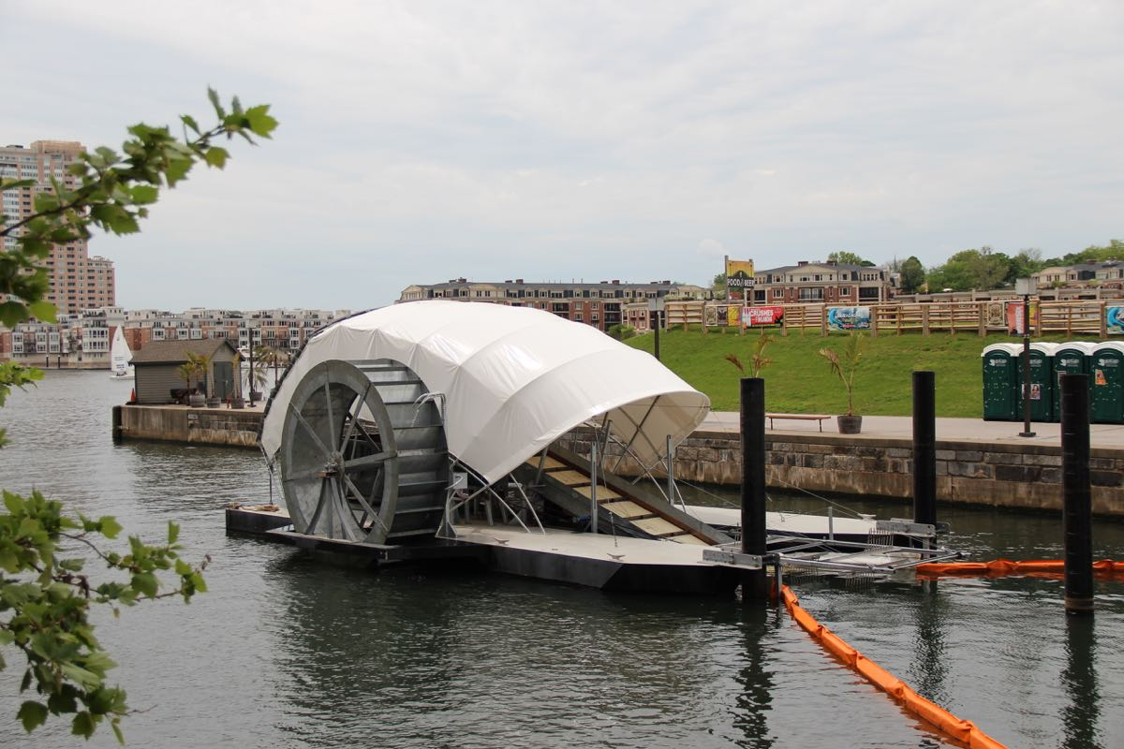
Innovative Soluation:
WHAT IS THE TRASH WHEEL?
The Trash Wheel is an efficient system used to decrease the amount of trash floating in the Harbor and eventually, the Chesapeake Bay.
The main source of the trash in our waterways is the Jones Falls, a river that runs through Baltimore.
Baltimorewaterfront.com

Slide 5
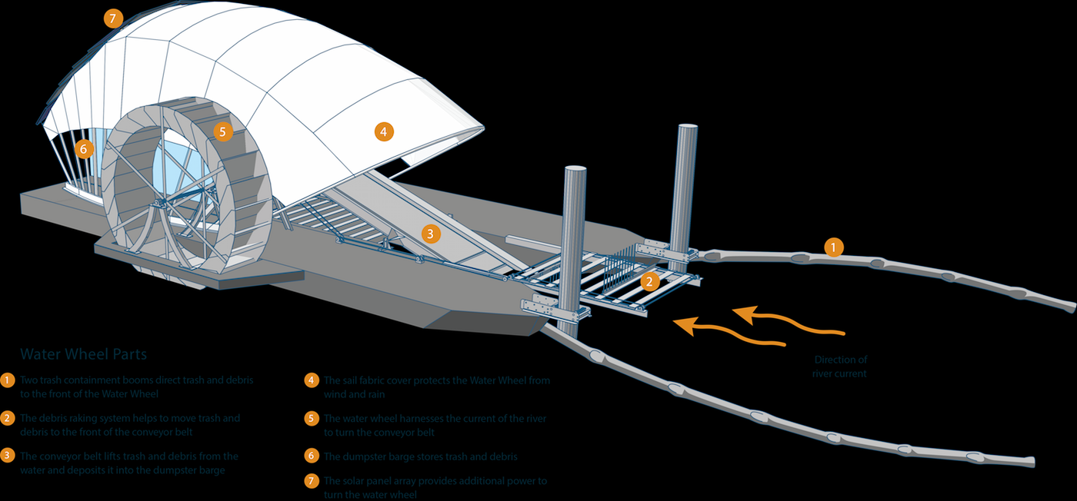
HOW IT WORKS
The array of solar panels on the roof of the Trash Wheel gives extra power to run the conveyor belt.
The wheel located on the left and right side harnesses the current of the water to turn the trash collecting conveyor belt.
The powerful conveyor belt lifts up trash and dumps in a large trash bag; storing it safely until it gets emptied.
http://www.cantonwaterwheel.com/

Slide 6

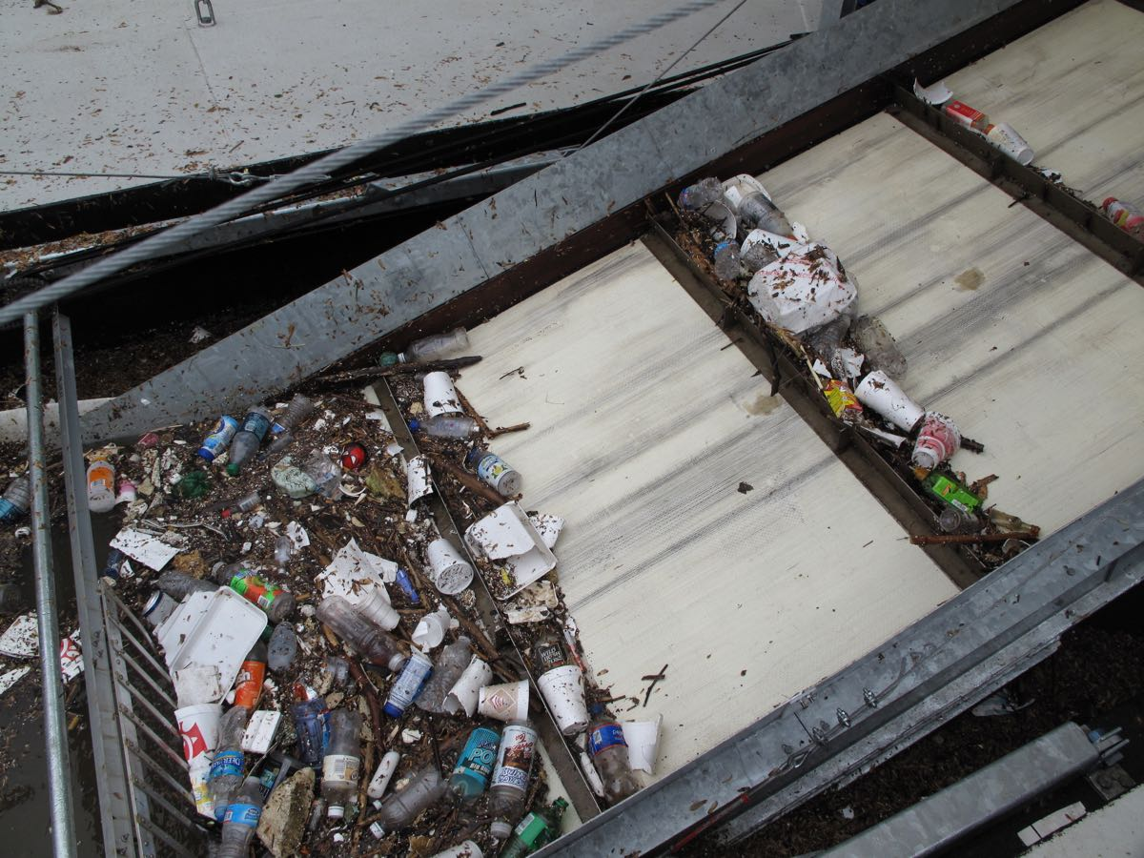


RESULTS OF THE INNOVATIVE SOLUTION
Across it’s first two years of trash collecting,
the Trash Wheel has collected a surprising
amount of common items:
234,820 PLASTIC BOTTLES
7,209,000 CIGARETTE BUTTS
150,180 PLASTIC BAGS
233,159 CHIP BAGS
    THE TRASH WHEEL HAS
    COLLECTED MORE THAN
    204 TONS OF TRASH!
http://baltimorewaterfront.com/healthy-harbor/water-wheel/

Slide 7
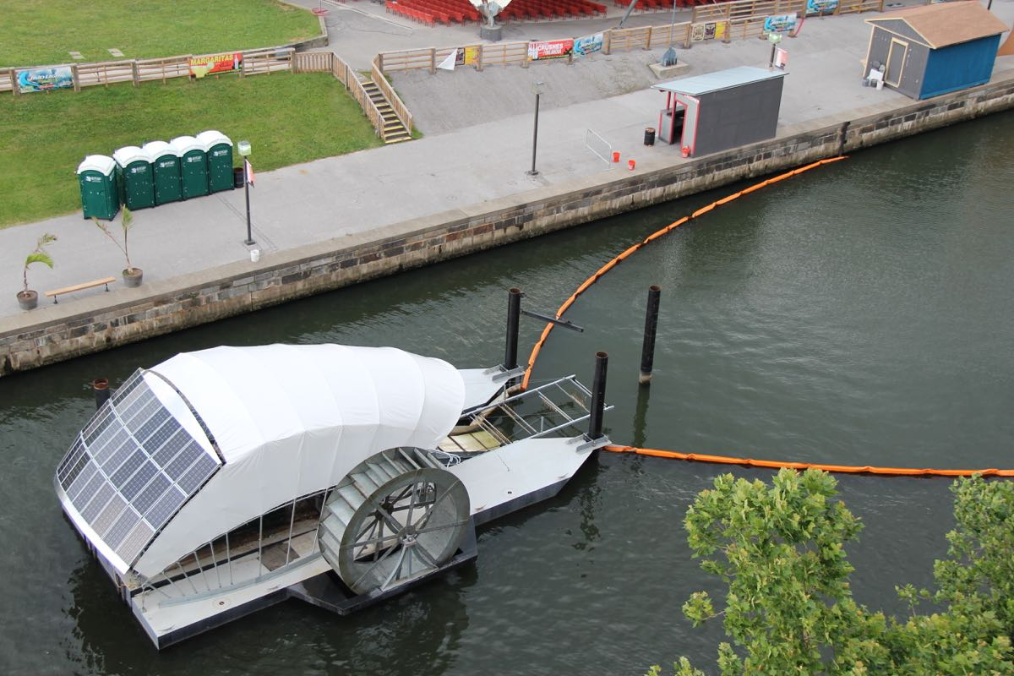
The Organizations Behind the Trash Wheel
Canton Water
Wheel
http://www.cantonwaterwheel.com/
Waterfront Partnership of Baltimore
http://baltimorewaterfront.com/
The mission of this organization is to promote the wellness of the waterfront of Baltimore. Their goal is to make the Inner Harbor swimmable and fishable by 2020.
Since the Trash Wheel started its work in May 2014, it has gathered 204 tons of trash from the Inner Harbor!
The mission of this organization is raise awareness of the problem of trash in our waterways and to raise money to purchase another trash wheel.
The organization has already raised $461,052 for the purchase of another trash wheel.

Slide 8
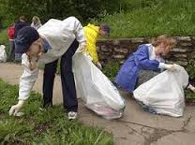


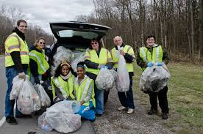

WHAT CAN YOU DO TO HELP?
Pick up trash in your own neighborhoods and parks so it doesn’t flow into the Jones Falls
Donate money for another trash wheel!
Spread the word!
Tell friends and family about the
problem of trash and how they
can help
Every bit counts!
Volunteer for community clean up

Slide 9
Lessons to Take Away From Centropa
Milton Wolf…Make things happen for those that need it most
Example of Survival in Sarejevo: Friendship in a Time of War
Our Example: The Trash Wheel
Despite the war tearing apart the community because of religious divides, a small group in the community pulled together to survive and thrive the best they could. This group worked together no matter anyone’s religion.
Provided food
Provided medicine
Provided friendship and support
Shared the story with others around the world
Despite the Inner Harbor being un-swimmable, unfishable, and ugly to look at, a group of individuals have banded together to come up with an innovative solution to help the health of our waterways with the goal of turning it all around by 2020.
Raised awareness of the problem of trash in the water
Taken action with one Trash Wheel resulting in 204 tons of trash removed in two years
Raised money for the purchase of another water wheel
Promoted cleaner water for wildlife and the citizens of the Baltimore community and beyond

Slide 10
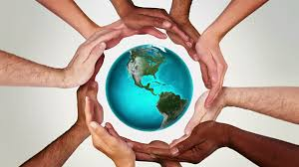
Take Home Points
Working together, anything is possible
Anyone can make a difference
Every little bit counts
If we do not take care of each other and our environment, we may not survive and we definitely will not thrive.
We are responsible for the health and well-being of each other, animals, and the environment.

