Slide 1
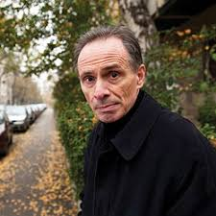
David Albahari
Born: 15 March 1948 in Peć (Peja), then PR Serbia, FPR Yugoslavia.
Died: 30 July 2023 in Belgrade, Serbia, at age 75.
Of Sephardic Jewish father and Serbian mother, with family survivor experiences from the Holocaust.
Graduated in English language and literature from the University of Belgrade Faculty of Philology.

Slide 2
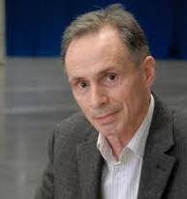
David Albahari
Known for blending postmodern experimentation with post-conflict realism, addressing exile, family history, trauma, and identity .
Authored 13+ novels, 11+ short story collections, essays, children’s books, and poetry
📚 Notable Works
Bait (Mamac, 1996) – novel exploring family, memory, the Holocaust; Snow Man (Snežni čovek, 1995); Götz and Meyer (1998); Leeches (2005); Checkpoint (2011) – all translated into English.
Words Are Something Else – English short story anthology.

Slide 3

Götz and Meyer: Tasks
Form the international group up to 6 participants
Every group will be given different extract from the novel Götz and Meyer
Read the given extract
In your group, discuss the questions on the next slide

Slide 4
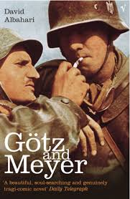
„Gotz and Meyer“ by David Albahari
What emotions or thoughts did this extract evoke in you, and how does the narrator’s voice influence your response?
Consider how Albahari uses calm, detached narration to describe deeply traumatic events. Why might he have chosen this approach?
How does this passage help us understand the mechanisms and consequences of systematic violence and memory—or the lack of it—in our societies?
What does this suggest about the way history is remembered, forgotten, or silenced—especially in relation to places like the Old Fairground?
Can you imagine using this extract in your classroom? If so, how would you frame it for your students, and what learning objectives would you want to achieve?
Would you pair it with local history, literature, personal testimonies, or visual materials? What challenges do you anticipate, and how might students respond?

